Slide 1



Youtube Song Analysis
Sriniha Mourila

Slide 2
Problem Statement
This project aims to conduct a comprehensive analysis of YouTube songs data using Power BI. The dataset contains key attributes such as video ID, channel title, title, description, tags, published date, view count, like count, favorite count, comment count, video duration, video definition, and caption details. The goal is to utilize Power BI to create insightful visualizations and reports that provide a deeper understanding of YouTube songs' performance, popularity, and user engagement. The analysis aims to uncover trends, preferences, and patterns in the data to aid content creators and stakeholders in optimizing their YouTube song content.

Slide 3
Project Objectives
1. Data Cleaning and Preparation
2. Exploratory Data Analysis (EDA)
3. Content and Channel Analysis
4. Temporal Trends
5. User Engagement Insights

Slide 4
Dataset Description
video_id: Unique identifier for each YouTube video.
channelTitle: Title of the YouTube channel publishing the song.
title: Title of the YouTube song video.
description: Description provided for the YouTube song video.
tags: Tags associated with the YouTube song video.
publishedAt: Date and time when the YouTube song video was published.
viewCount: Number of views received by the YouTube song video.
likeCount: Number of likes received by the YouTube song video.
favoriteCount: Number of times the YouTube song video has been marked as a favorite.
commentCount: Number of comments posted on the YouTube song video.
duration: Duration of the YouTube song video.
definition: Video definition or quality (e.g., HD, SD).
caption: Availability of captions for the YouTube song video.

Slide 5
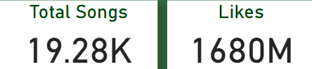
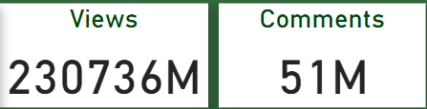
Insights
This dashboard report presents an in-depth analysis of YouTube song data, focusing on key metrics such as total views, likes, comments, and the distribution of songs over the years. This analysis aims to uncover trends and insights that can inform content strategy and engagement optimization.
Key Metrics
Total Songs: 19.28K
Total Likes: 1680M
Total Views: 230736M
Total Comments: 51M

Slide 6
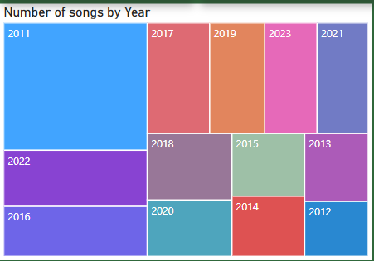
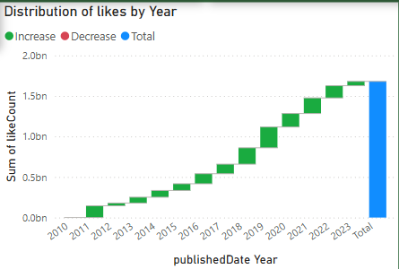
Findings
Number of Songs by Year
The treemap visualization highlights the distribution of songs by year. Notably, the years 2011 and 2016 have the highest number of song uploads, indicating significant content creation periods. Other active years include 2017, 2019, 2021, and 2023.
Likes by Year
The waterfall model shows a steady increase in the number of likes from 2010 to 2022, with a peak in the later years. This trend suggests a growing engagement with YouTube songs over time.

Slide 7
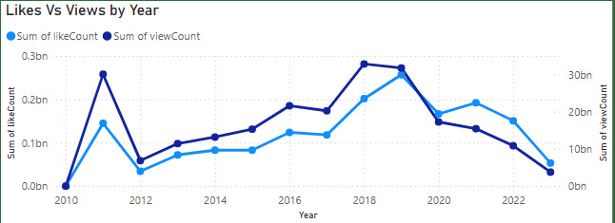
Findings Cont..
Likes vs. Views by Year
The dual-axis line chart compares the sum of like counts and view counts by year. While there is a general correlation between likes and views, the disparity in units makes it challenging to visualize both metrics simultaneously without scale adjustments.

Slide 8
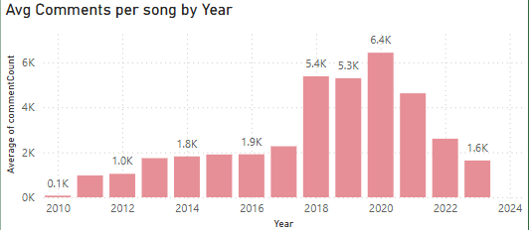
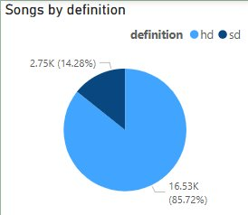
Findings Cont..
Average Comments per Song by Year
The bar chart demonstrates variability in average comments per song by year. Significant spikes are observed in 2018 and 2020, suggesting higher engagement levels during these years.
Songs by Definition
The pie chart indicates that the majority of songs are in SD definition (85.72%), with a smaller proportion in HD definition (14.28%). This reflects the format preference of uploaded songs.

Slide 9
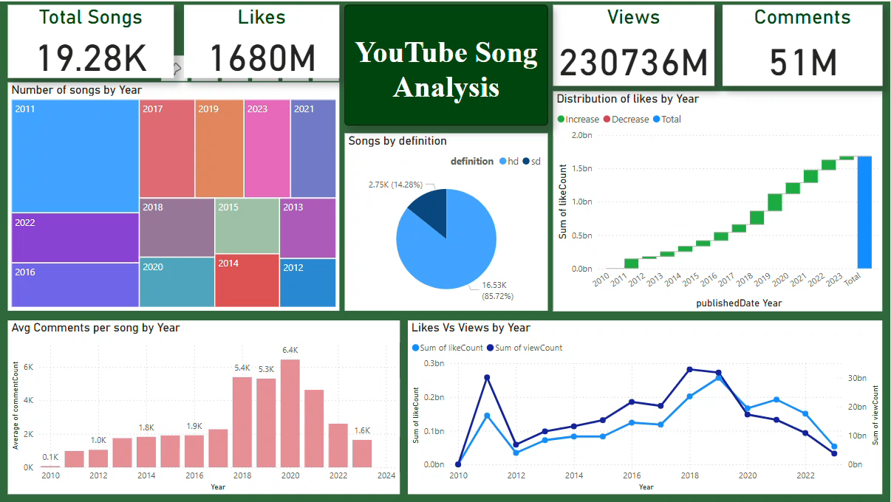
Power BI Dashboard

Slide 10

Thank you

